Slide 1



Beginners TouchDesigner Workshop
20-4-2024 Creative Coding Utrecht
by Digital Piglet (Raul Leal)

Slide 2
Coming up
23rd of April TouchDesigner workshop - Sensors & OSC
25th TouchDesigner meetup

Slide 3
Hi my name
is Raul Leal

Slide 4

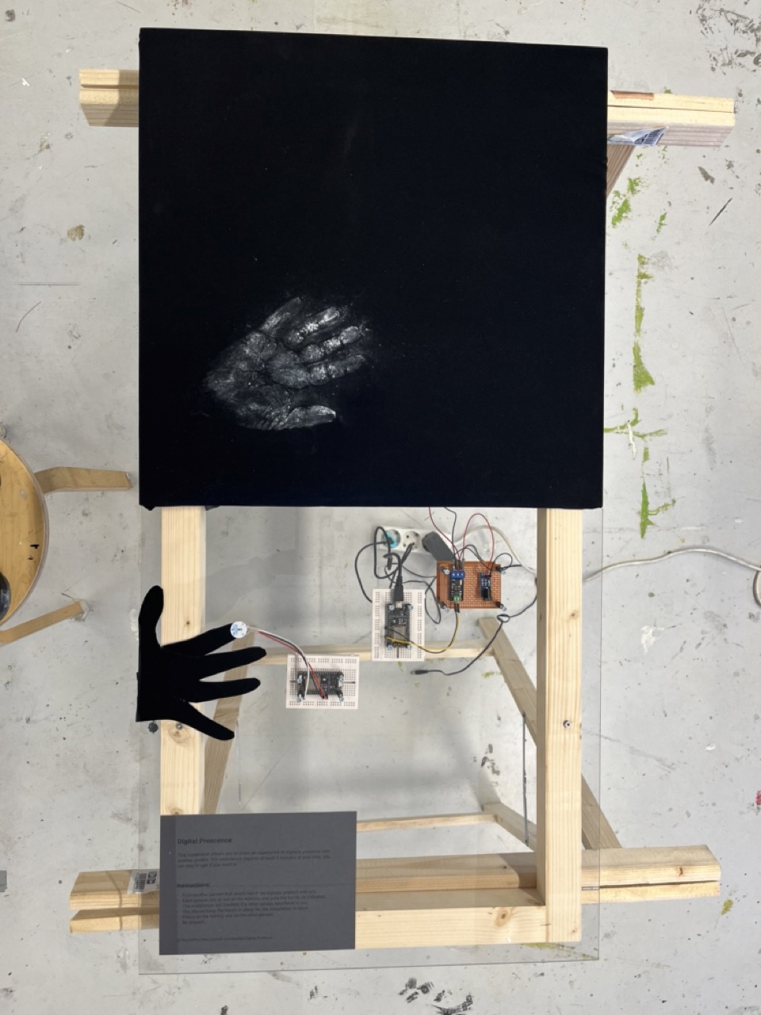
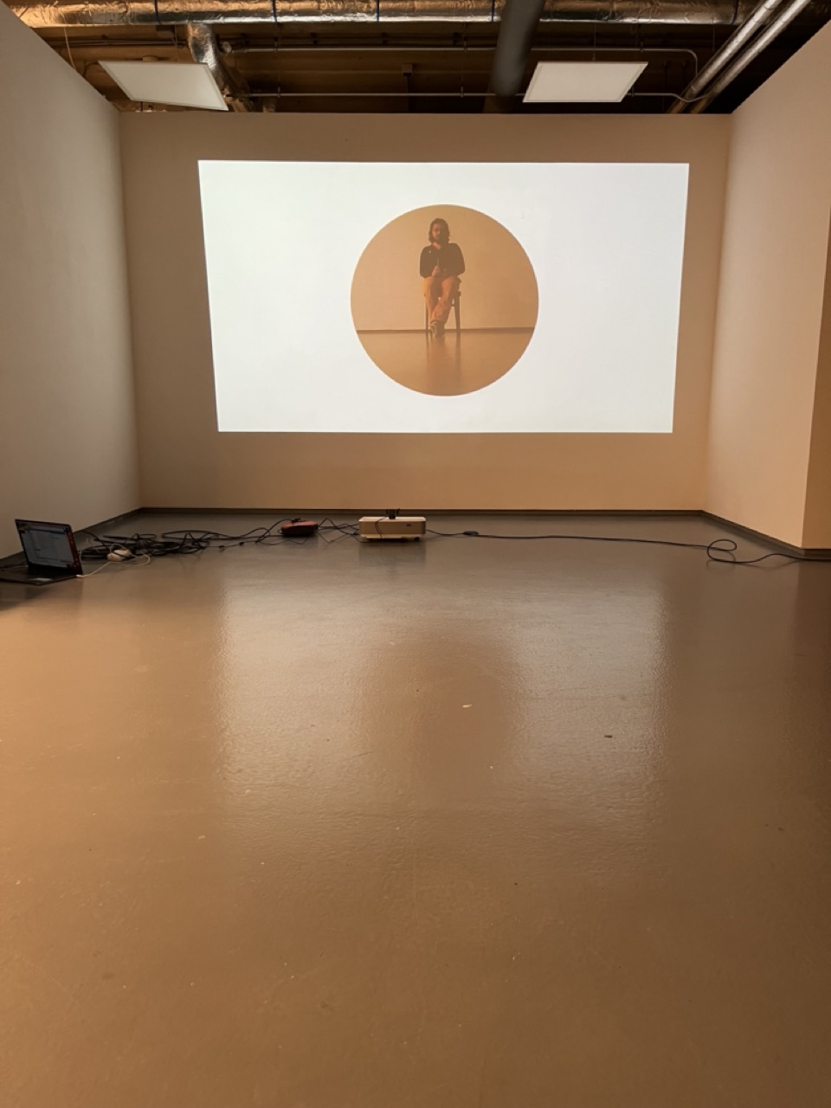
Me
Creative technologist
Rietveld – DogTime Unestable Media
In my practice I aim to use technology as companion for creation instead of simply as a tool

Slide 5
This workshop
What will do
What we will not do
Basic Introduction
Programming with TD
Common useful logic patterns
Assigning references
Bauhaus motion graphics
Have fun
No 3D
No Particles
No Kinect

Slide 6

The workshop structure
Intro
Draw things
Make them move
Add logic to the movement
Make them audio reactive
Make them interactive
Make an interface for them
Involve a sensor
Next Workshop

Slide 7
Constrains for the workshops…
It is done in
TochDesigner and...
Only uses...
Only uses...
It is a 2d animation,
i.e no 3d scenes, objects etc..

Slide 8
TouchDesigner
Node based programming language
Essentially function composition f(g(h(x)))
Very good for making data into visuals (not scientific)
Very good for sensor data and sending it back to devices
Not good to make sound – go to Ableton or Max
Good to orchestrate midis though

Slide 9
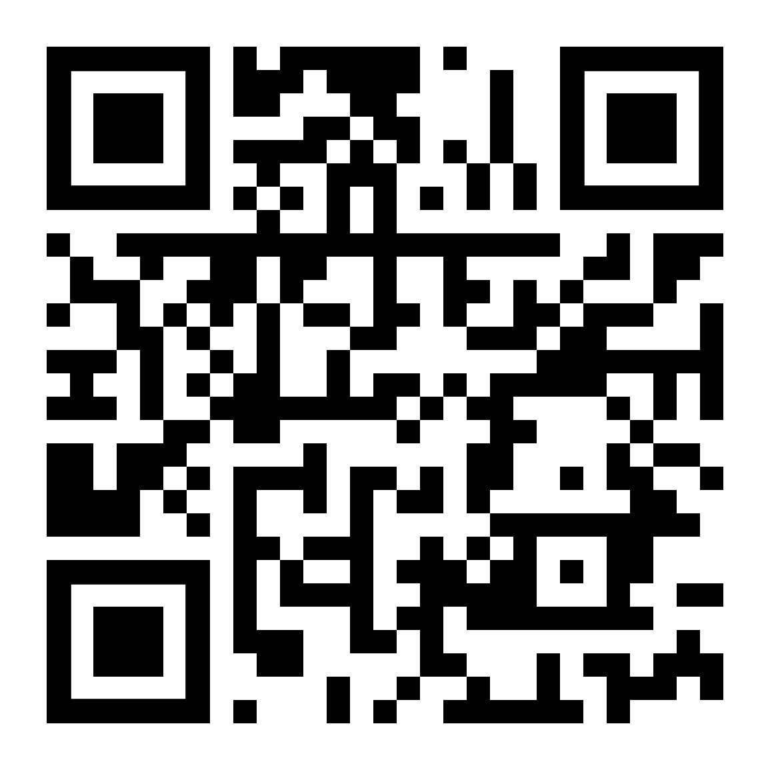
Practial Info
WIFI: ccu
WW: Code03084
https://discord.gg/dWyuS96jD6

Slide 10
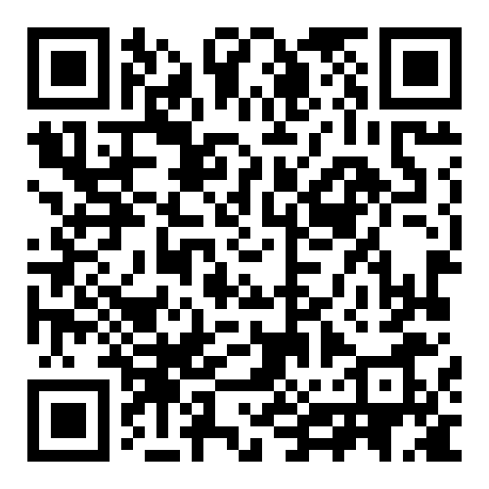
Git repository for these workshops
https://github.com/Rauleal/TouchDesigner_Bauhaus_workshop

Slide 11
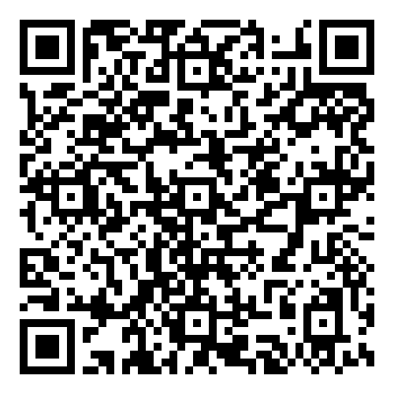
YouTube channel
https://www.youtube.com/watch?v=AMGkNHyQ4o0&list=PL3zGSOEHGdiR5x5BIg8E8yn2BQMbQ6igb

Slide 12
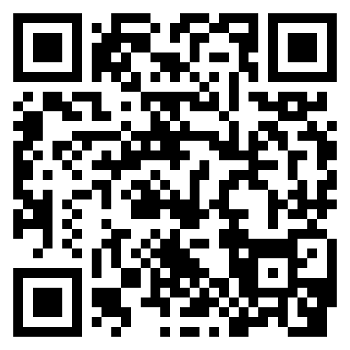
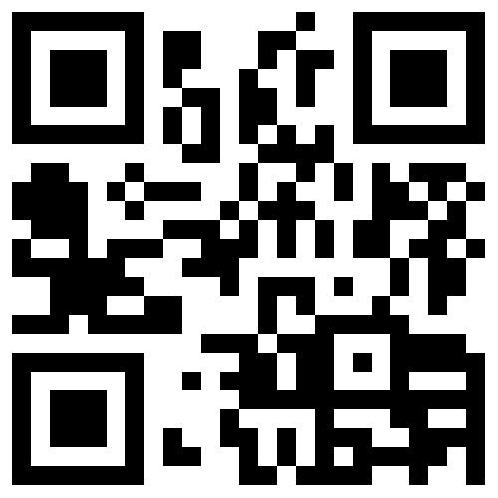
Email_to: raul.andres.leal@gmail.com
https://www.instagram.com/raul.andres.leal/
https://rauleal.com/

Slide 13
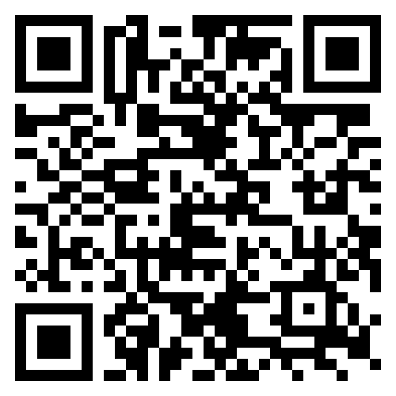
TouchDesigner Documentation
https://docs.derivative.ca/Main_Page

Slide 14
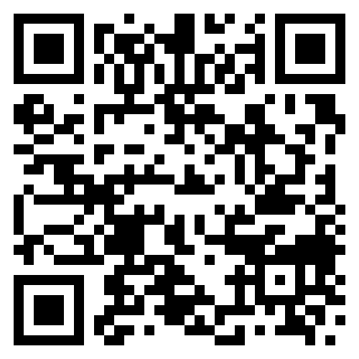
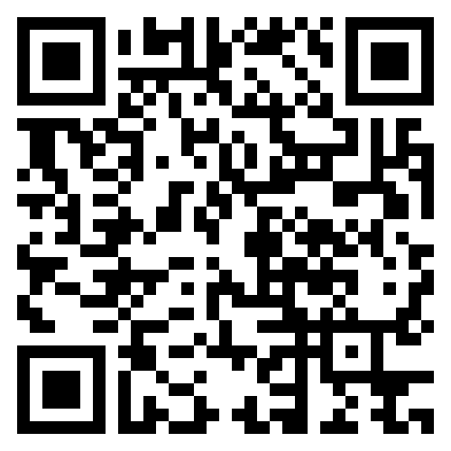
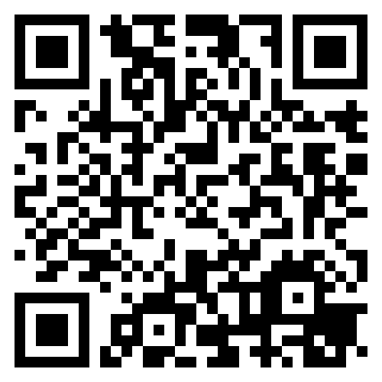
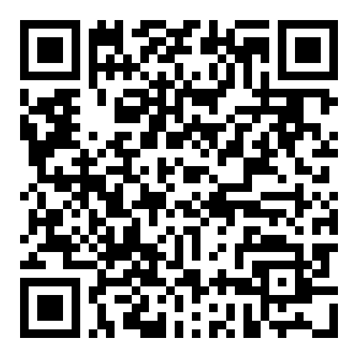
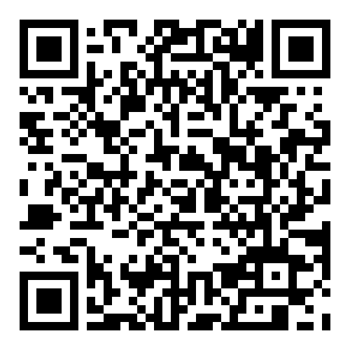
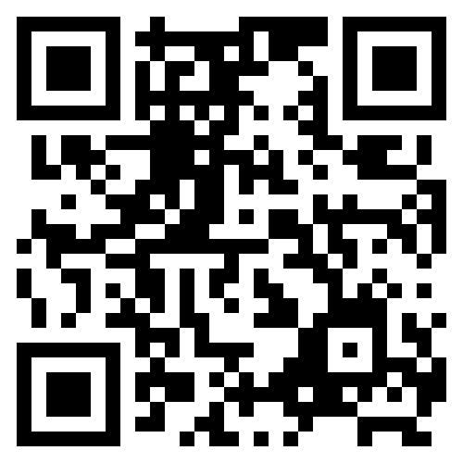
Interesting Artist/tutorials
Elekktronaut
Paketa12
Noto the talking ball
The Interactive Immersive HQ
Derivative fundamentals
Node Institute

